Slide 1
RISC + ASM Pt2
Thomas Haimes

Slide 2
Corrections made
Split RISC into the four pipelines to create:
IF.v
DOF.v
EX.v
WB.v
Did some module debugging to fix signals
Added displays (never used before)
Added header file (first time too)

Slide 3
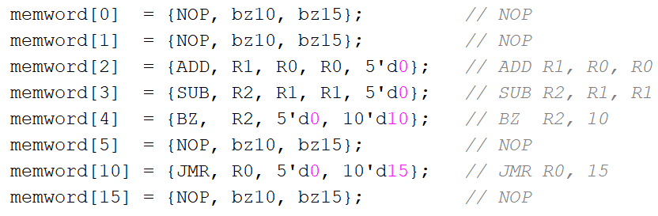
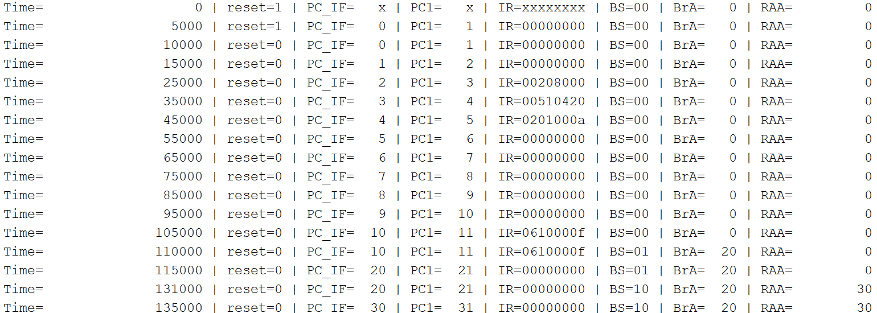
IF Correction

Slide 4
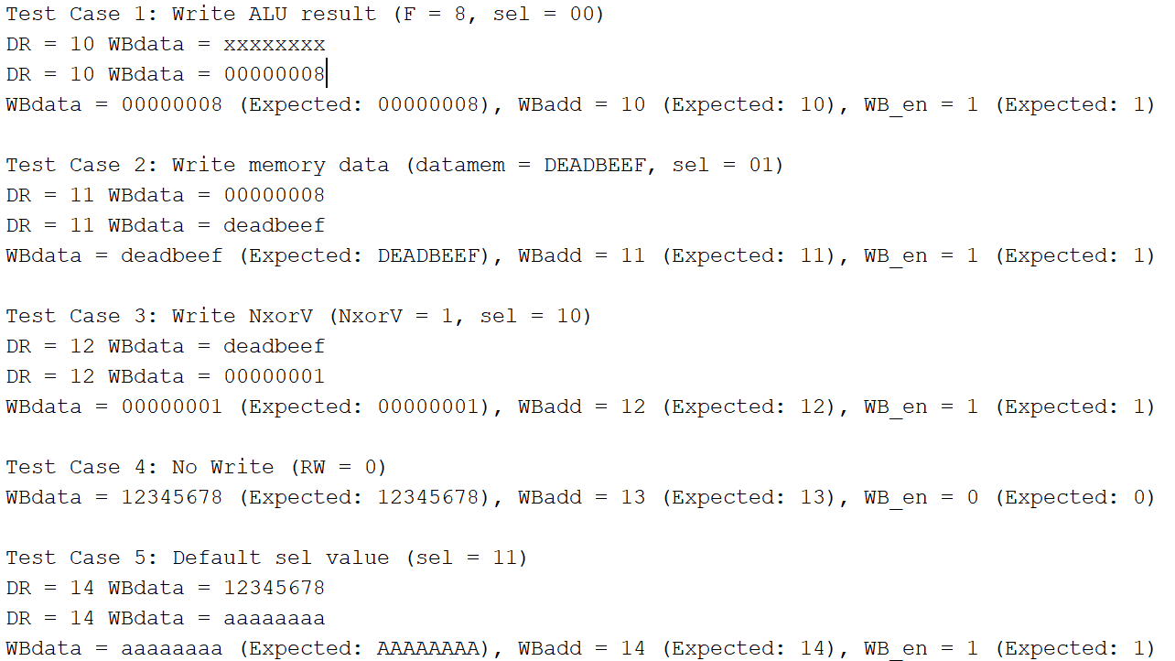
WB Correction

Slide 5
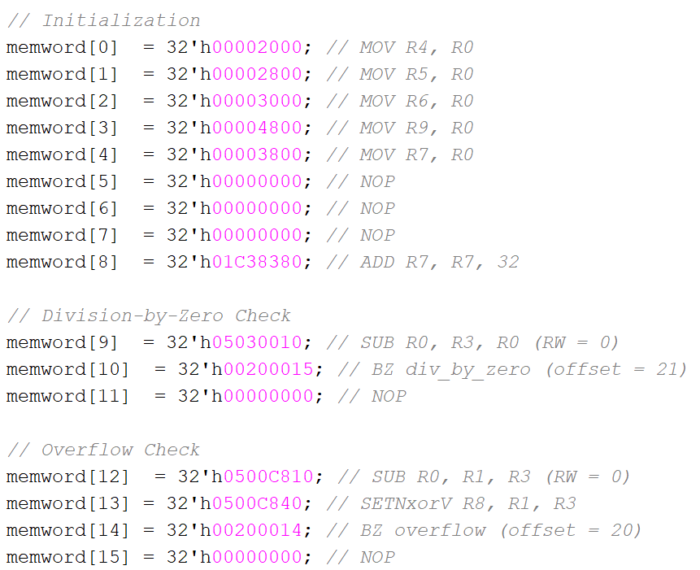
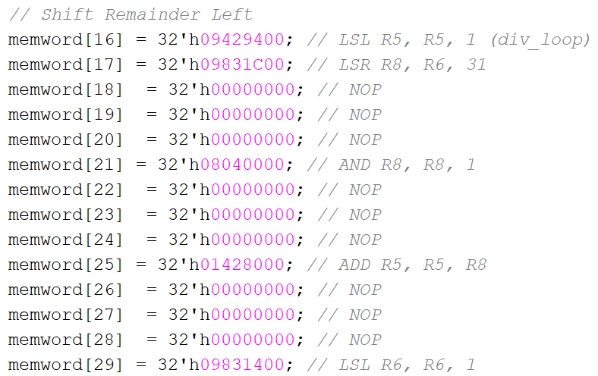
Division

Slide 6
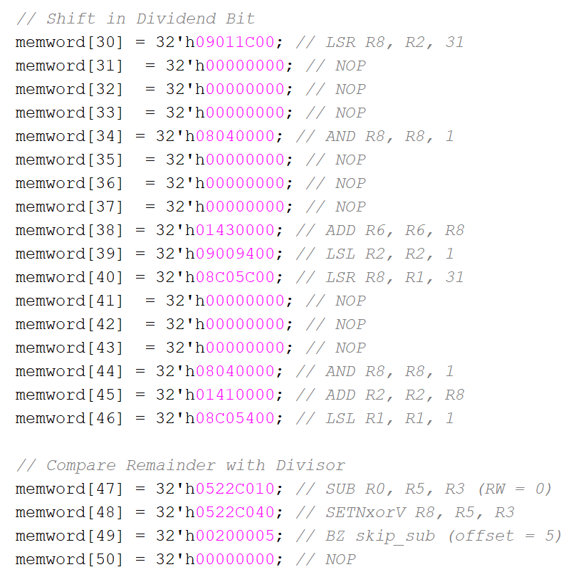
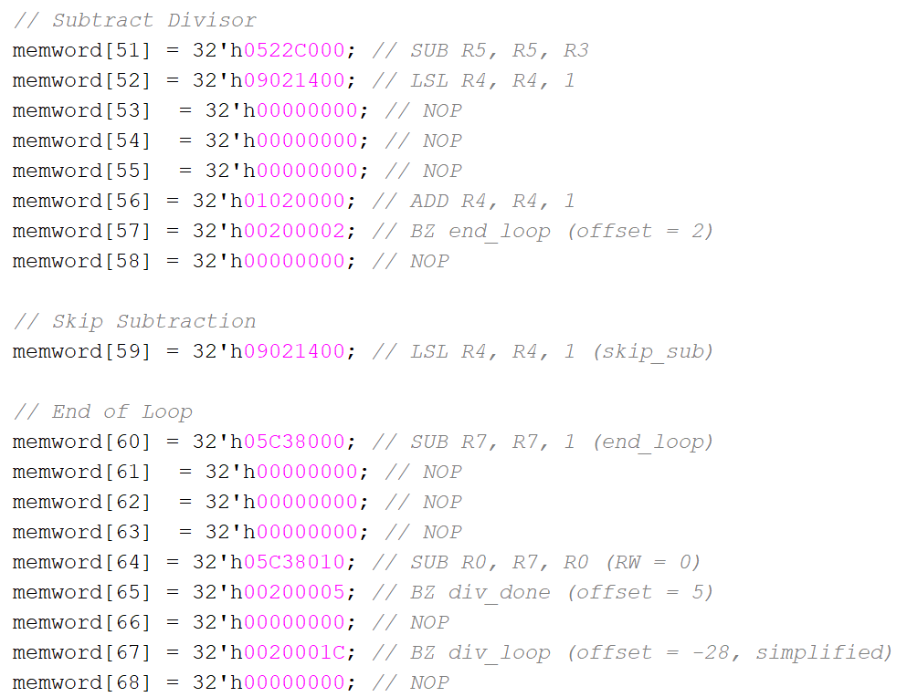
Division cont

Slide 7
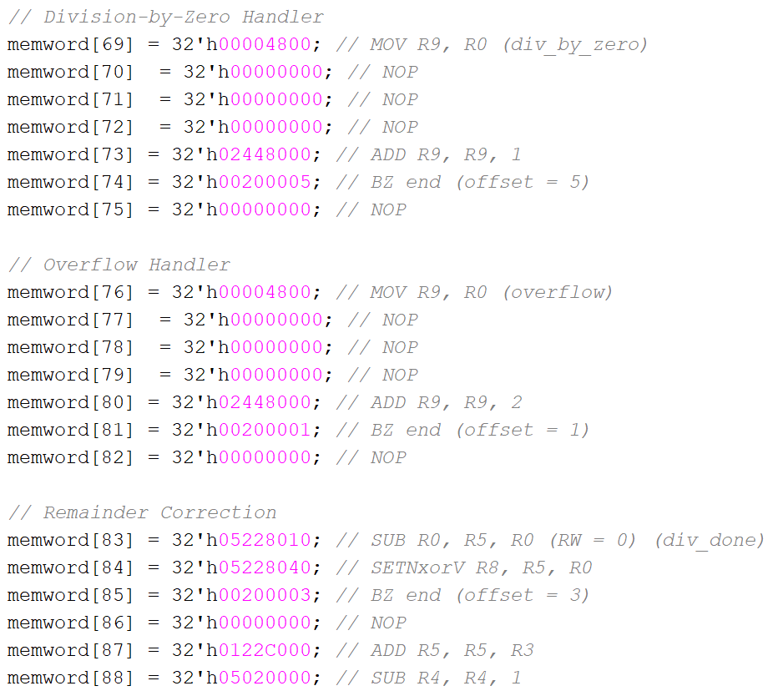
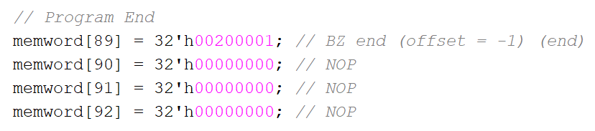
Division cont

Slide 8
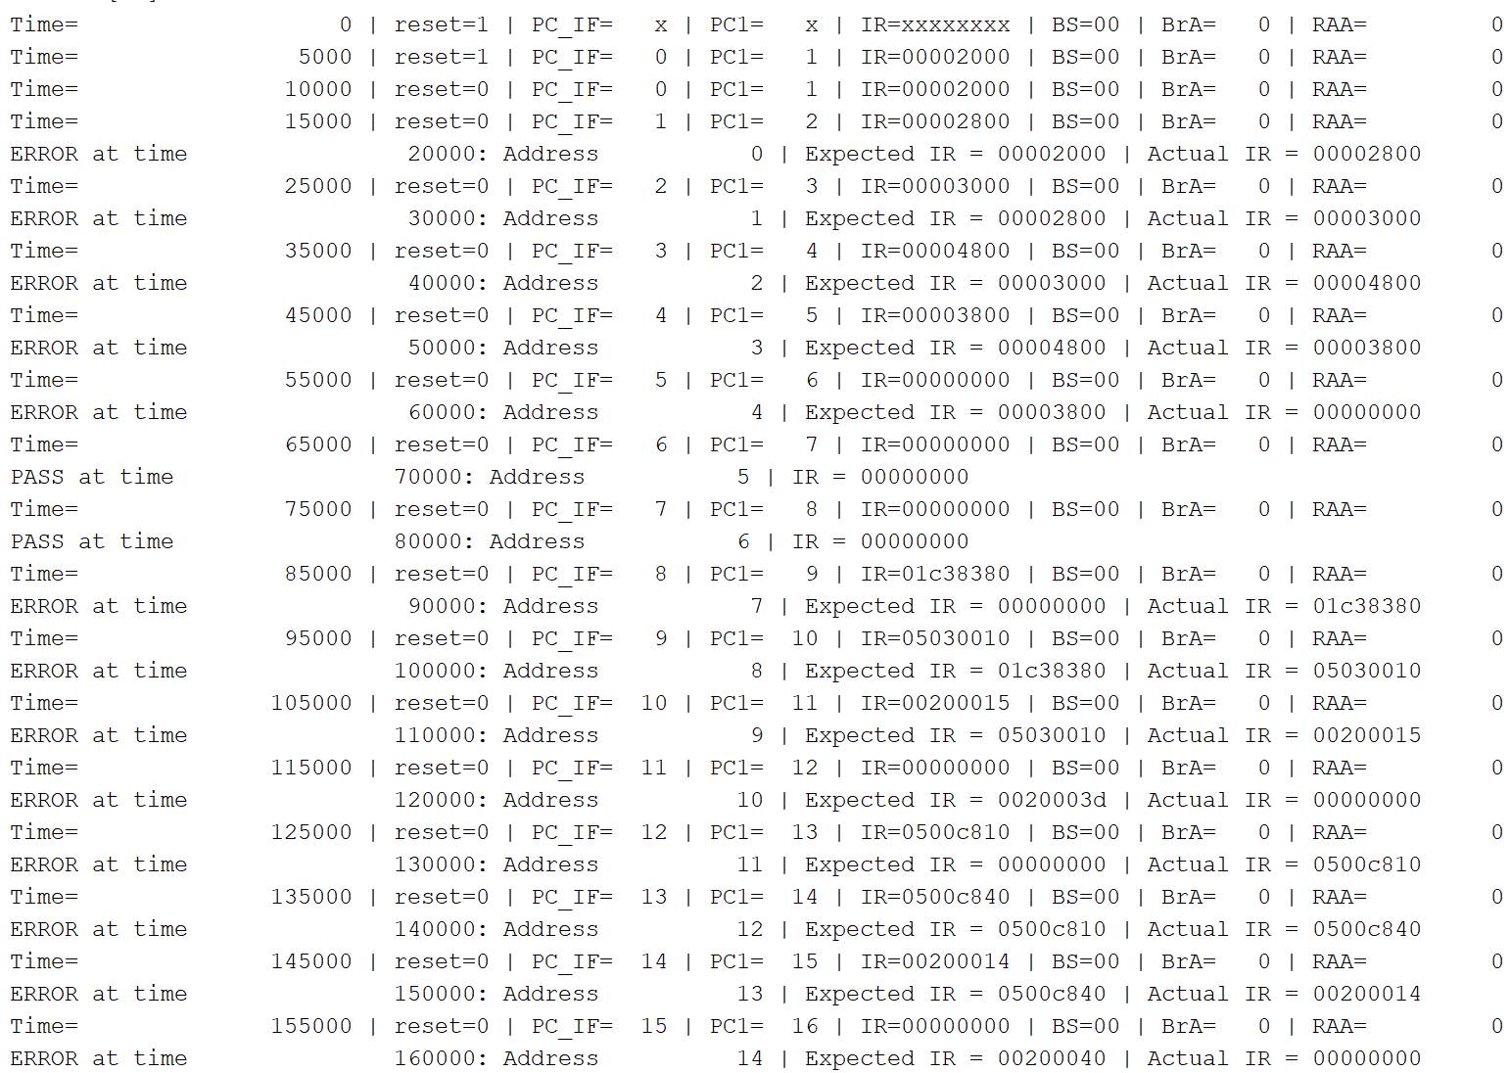
Division Output

Slide 9
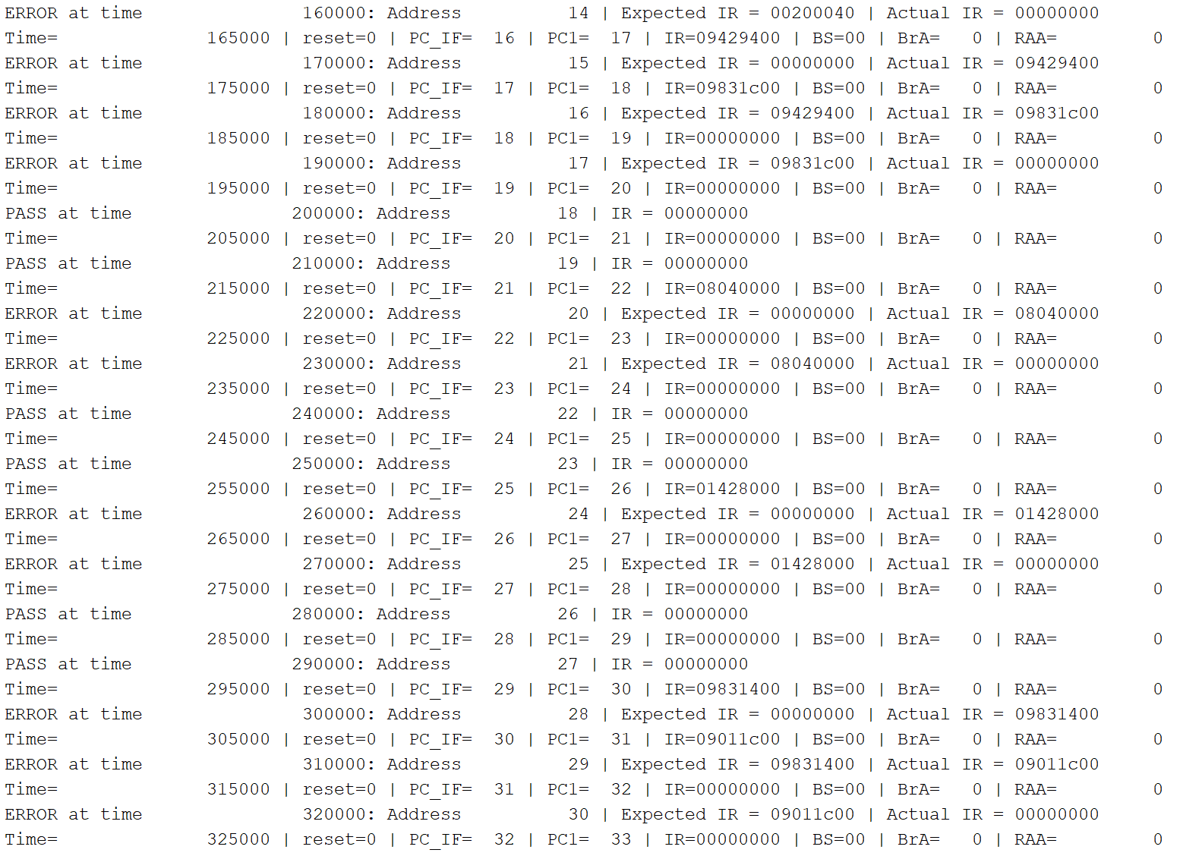
Division Output cont

Slide 10
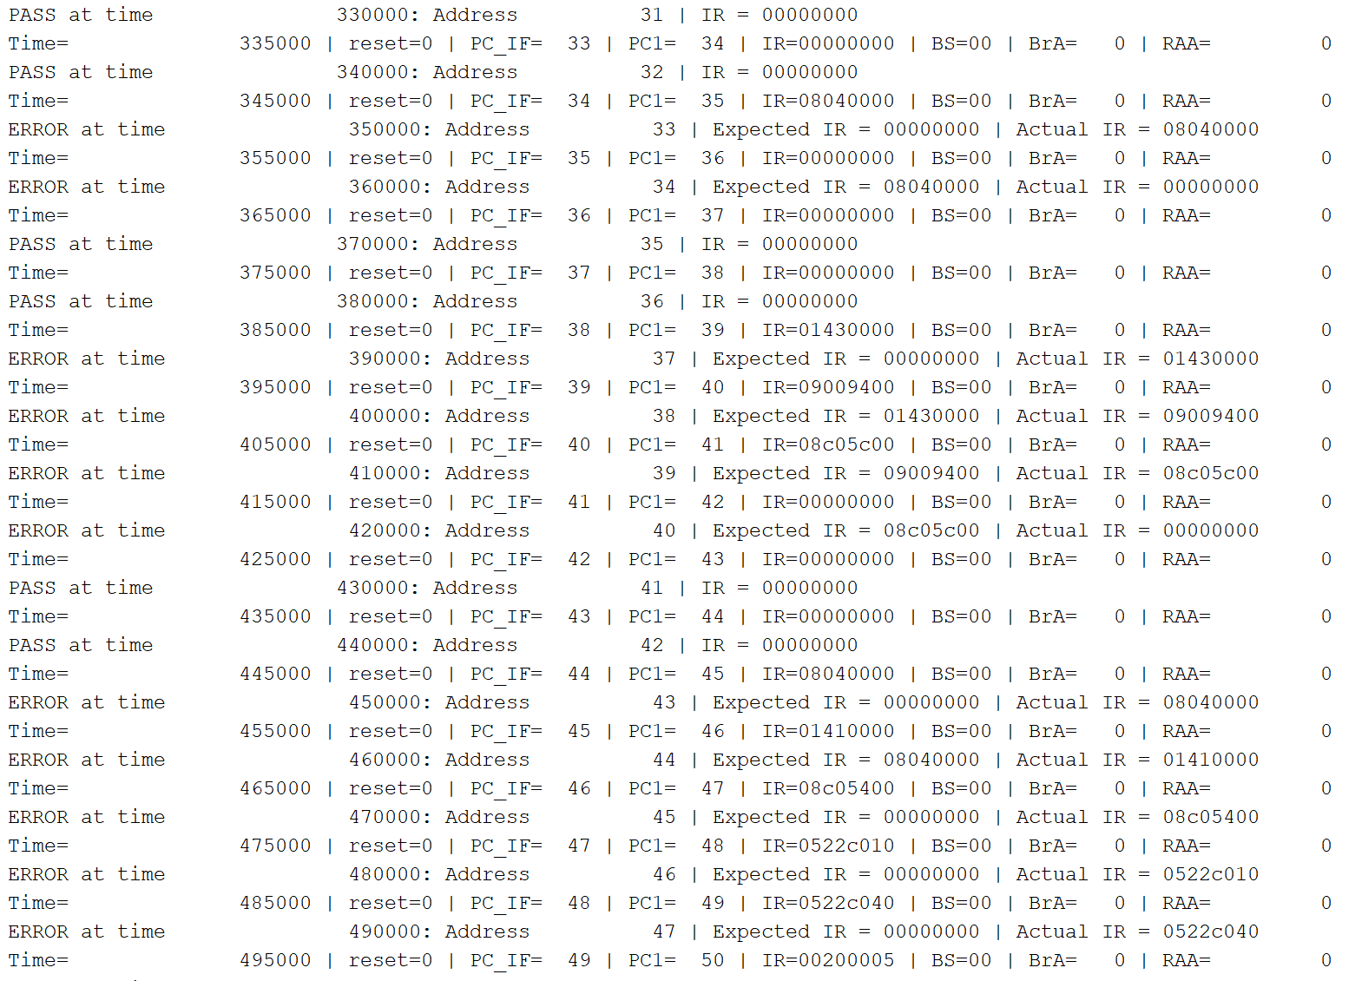
Division Output cont

Slide 11
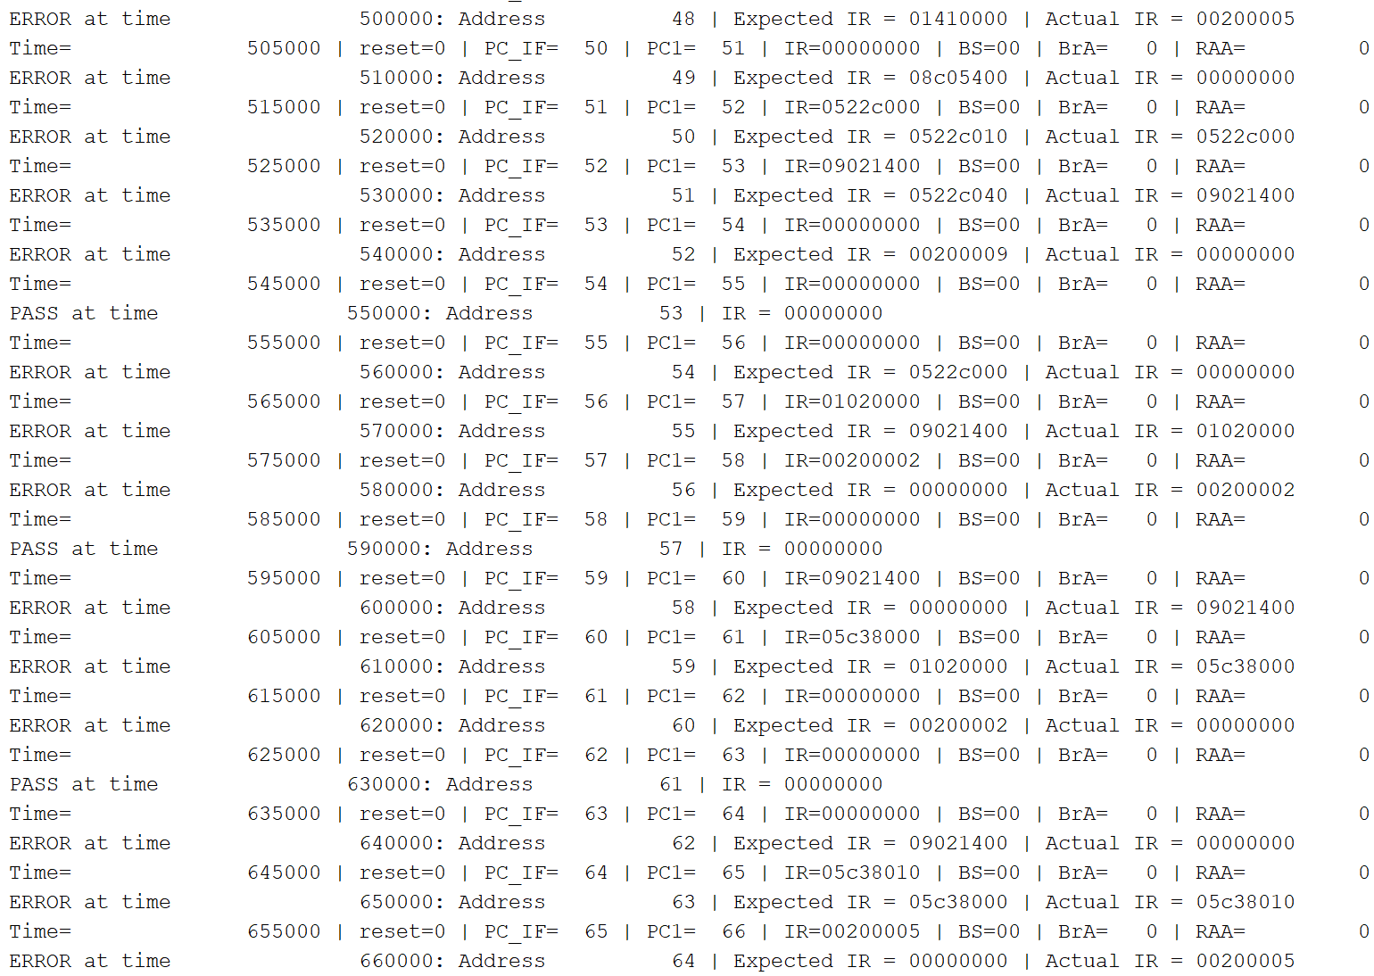
Division Output cont

Slide 12
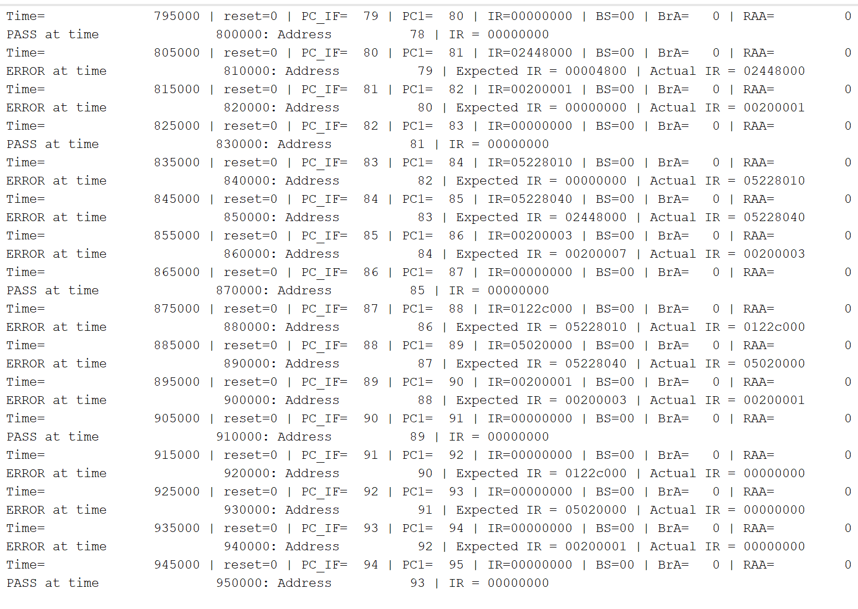
Skipped a bit ahead

Slide 13
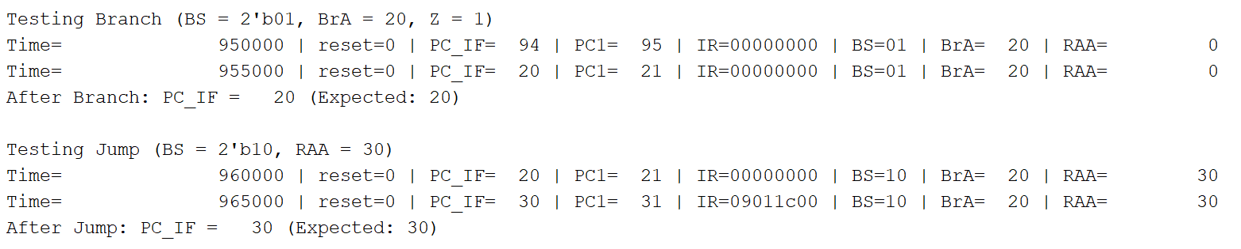
Some Tests

Slide 14
Conclusion
Some issues persist within the unit
Division has many errors
Career choices have been made

